Slide 1
POWER BI
NOTES

Slide 2
LESSON 1:
Introduction to Business Intelligence and Power BI

Slide 3
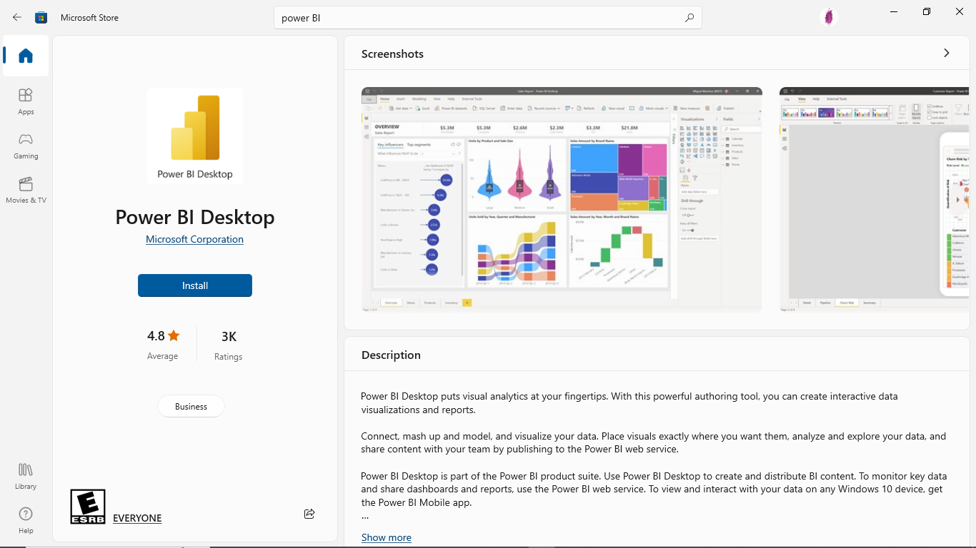
Downloading and running Power BI Desktop
Power BI Desktop (the trusted Microsoft Store app)
It is the preferred Power BI Desktop application to install and use. Microsoft recommends this version of the Power BI Desktop as it is specifically built for use on 64-bit, Windows 10 and keeps itself updated automatically.
This version of the desktop works like other Windows apps as in it is automatically updated when there is a new version.
Steps to downloading:
Open this link in a web browser, http://aka.ms/pbidesktop and run.
The Microsoft Store app will open automatically to the Power BI Desktop app.
Click Get and this will start the download and installation process.
Once the download and installation process are complete, the Install button will turn into a Launch button.
Click the Launch button.

Slide 4
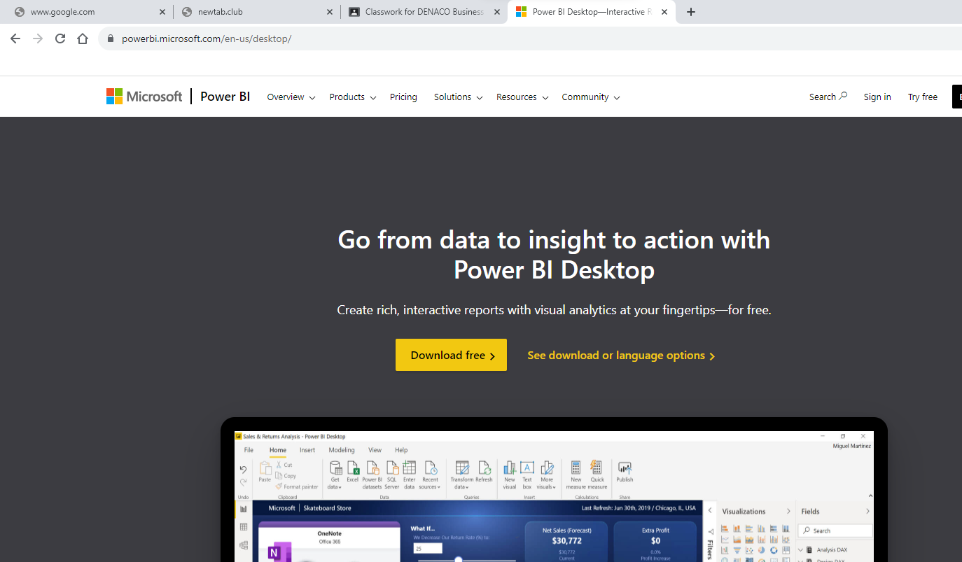
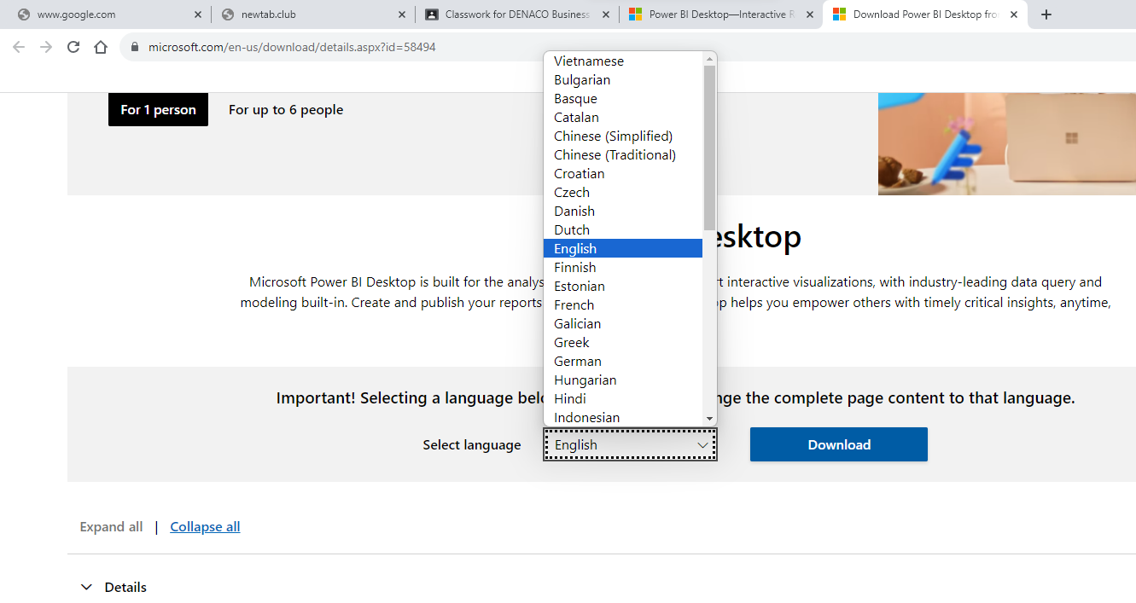
Downloading and running Power BI Desktop
Power BI Desktop (EXE)
For a variety of reasons, it may not be possible to install the trusted Microsoft Store app version of Power BI Desktop. This may be due to corporate policies or because you wish to install the 32-bit (x86) version of the desktop.
Use the following procedure to install the MSI version of the Power BI Desktop:
Open this link in a web browser, https://powerbi.microsoft.com/desktop/ and run it.
Click See download or language options.
A new browser tab will open.
Select your language and then click Download.

Slide 5
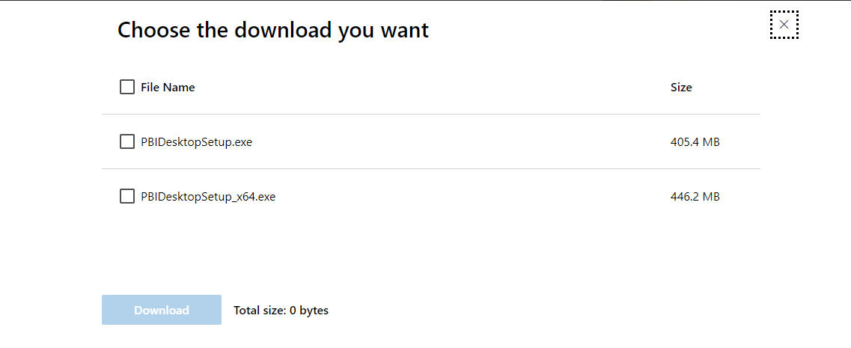
Downloading and running Power BI Desktop
Power BI Desktop (EXE)
5. Choose PBIDesktopSetup.exe or PBIDesktopSetup_x64.exe and then click Next
NB The _x64 version is for 64-bit operating systems and that the other file is for 32-bit operating systems
6. Once the download is complete, run the EXE installer file.
7. Once the installation launches, follow the prompts.
8. Accept the license terms
Click Install and finish, Power BI should now be up and running..

Slide 6
Introduction to business intelligence
Business intelligence refers to a set of tools and processes to help companies manage their data from the collection to the reporting stage. Through this, organizations can discover valuable trends and insights to inform their strategies and ensure continuous growth.
Exploring key concepts of business intelligence
As mentioned: We live in a world rife with digital data, and without using it to your advantage, you will quickly fall behind the pack, which will render your empire obsolete in a matter of years.
But as powerful as digital data is for decision-making and improved business efficiency, it’s only advantageous if you know how to handle it the right way. That’s where today’s BI concepts come in.
1. They prevent you from drowning in data
The fact is, without business intelligence, you risk the very real possibility of drowning in data. Just look at these numbers: according to CloudTweaks, in 2015 there were 2.5 quintillion bytes of data produced daily. Do you know how much a quintillion is? It’s a 2.5 followed by 18 zeros. For scale, in 2010, the entire Internet only produced 2 zettabytes. How’s that for exponential growth?
Depending on how you see it, this incredible amount of data is either a huge headache or the world’s greatest opportunity. On the one hand, there are more possible useful information points out than ever. But, on the other hand, there’s much more noise standing in the way of you finding that useful signal than ever before.
2. They provide a wealth of insights
By utilizing self service BI tools for your business, you’ll be able to extract a wealth of insights that will help improve interdepartmental and external communications, problem-solving processes, online data analysis, financial efficiency, goal-setting, marketing, and profitability.
The best part is, their self-service nature enables anyone in the organization to collect, monitor, and analyze data and use it to optimize their daily operations. This was not possible in the past, as all analytical tasks were segregated to the IT department leaving the rest of the departments out of the process.

Slide 7
Exploring key concepts of business intelligence
3. Benchmarking is more accurate
By working with BI-based key performance indicators (KPIs), you’ll gain the ability to set actionable goals and benchmarks based on your actual performance. In turn, this will accelerate your overall success by helping you to formulate strategies more effectively and work towards essential benchmarks more efficiently. By choosing and setting the right KPI template for your business, you will be able to evaluate your goals and progress on a deeper and more accurate level.
4. You can predict your business's future
Another key benefit of the business intelligence process is the ability to predict future scenarios. Online BI tools and solutions offer a viable means of predicting future outcomes and putting plans in place to either prevent calamities from occurring or take advantage of potential trends before your competitors.
They do this through the use of predictive analytics processes that offer a digestible mix of historical and real-time data enabling companies to identify trends and patterns witing their information. These insights are later turned into accurate forecasts that help organizations plan their future strategies. For example, a business can analyze historical sales data to predict specific product demand and ensure accurate levels of inventory.
5. They enable powerful data visualization
If you’re able to visualize your data with the help of online data visualization, making it digestible to the human eye, you’ll be able to tell a story with your insights and communicate your discoveries to others more effectively. Doing so will boost the success of your organization, making it more powerful than ever before.
BI solutions will help you do just that by providing highly interactive and visually pleasing dashboards. Dashboards offer a centralized view of a company’s most important KPIs to support meetings and discussions. Their visual nature makes it easier to explore the data and show relevant findings to different audiences. We will see some examples of BI dashboards for different departments later in the post.

Slide 8
Key Features Of Power BI
Some of the main features of Power BI are listed below:
Supports API Integrations: Power BI allows developers to easily integrate with other applications and embed dashboards into other software using sample codes and APIs.
Custom Visualization: Power BI offers custom visualization libraries support that allows users to visualize complex data with ease.
AI Support: Users can easily perform Data Analytics using Artificial Intelligence. With the built-in AI support, users can prepare data, build Machine Learning models, and gain insights.
Modeling View: With the help of Modeling View, Power BI users can slice and divide the complex data into simpler ones that help in better understanding the data, separate diagrams, and multi-select objects.
Easy Sharing: Power BI makes it easier for users to easily share their reports within teams, or organizations ensuring full data protection.
Hybrid Development: Power BI easily integrates with many 3rd party connectors, applications, and services widely used by organizations that allow users to connect to various data sources.

Slide 9
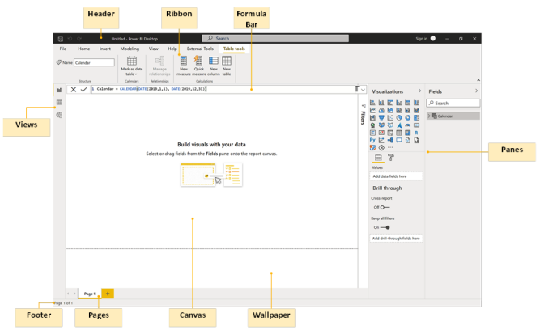
Power BI Desktop Interface

Slide 10
Building Blocks in Power BI
Building Blocks in Power BI
Datasets Dataflow’s source data or the collection of data that are imported are called Datasets. Each of these datasets is connected to Power BI to make them be stored in one single place.
Visualization When the data are represented in the form of charts/graphs/diagrams/ any other form of visuals, it is called visualization. These help in reforming the data for a better understanding.
Reports The visual representation of any collected data is called Reports and they include charts, maps, graphs, and even treemaps. These reports can be created in Power BI and can be shared through dashboards, with one’s friends
Dashboards A single sheet that consists of numerous widgets and tiles is called Dashboards. These are either created by the user himself or are borrowed from the one created and shared by their colleague in the Power BI service
Tiles Each and every visual data stored in the dashboards are called a Tile. In other words, the Dashboard is a collection of Tiles.

Slide 11
LESSON 2:
Working with Data and Data Modeling

Slide 12
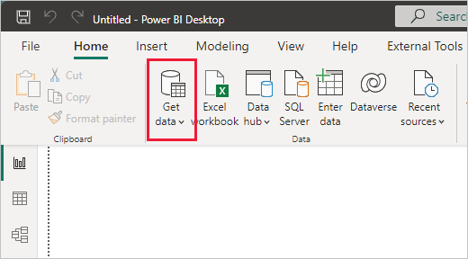
Connecting to various data sources
With Power BI Desktop, you can connect to many different types of data. These sources include basic data sources, such as a Microsoft Excel file. You can connect to online services that contain all sorts of data, such as Salesforce, Microsoft Dynamics, Azure Blob Storage, and many more.
1. To connect to data, from the Home ribbon select Get data.

Slide 13
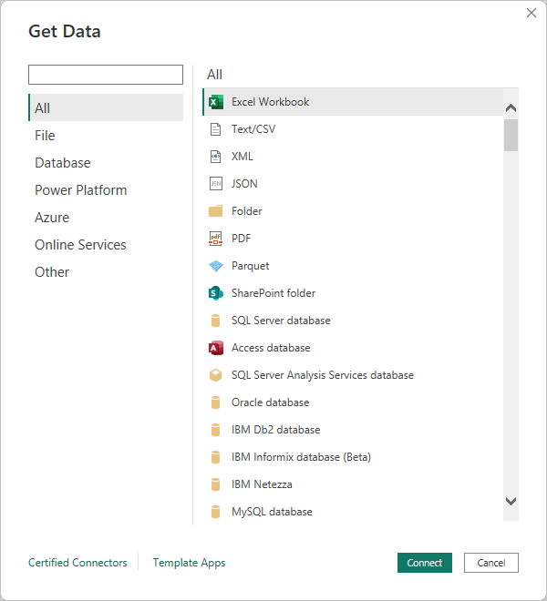
Connecting to various data sources
2. The Get Data window appears. You can choose from the many different data sources to which Power BI Desktop can connect.

Slide 14
Connecting to various data sources
All: This lists all of the available connectors.
File: File connectors, including Excel, text/CSV, XML, JSON, folder, PDF, and SharePoint folders.
Database: The Database section lists sources such as SQL Server, Access, Oracle, IBM DB2, IBM Informix, IBM Netezza, MySQL, PostgreSQL, Sybase, Teradata, SAP, Impala, Google BigQuery, Vertica, Snowflake, Essbase, and AtScale.
Power Platform: Power Platform includes Power BI datasets and dataflows, as well as Dataverse.
Azure: Azure lists many different services, such as Azure SQL Database, Azure Synapse Analytics, Azure Analysis Services, Azure Blob Storage, Azure Table Storage, Azure Cosmos DB, Azure Data Lake Storage, Azure HDInsights (HDFS), Azure HDInsights Spark, Azure Data Explorer (Kusto), Azure Databricks, and Azure Cost Management.
Online Services: There is a substantial collection of online services, including Microsoft technologies such as SharePoint Online, Exchange Online, Dynamics 365, Common Data Service, DevOps, and GitHub, as well as third parties such as Salesforce, Google, Adobe, QuickBooks, Smartsheet, Twilio, Zendesk, and many others.
Other: other connectors include Web, OData, Spark, Hadoop (HDFS), ODBC, R, Python, and OLE DB.

Slide 15
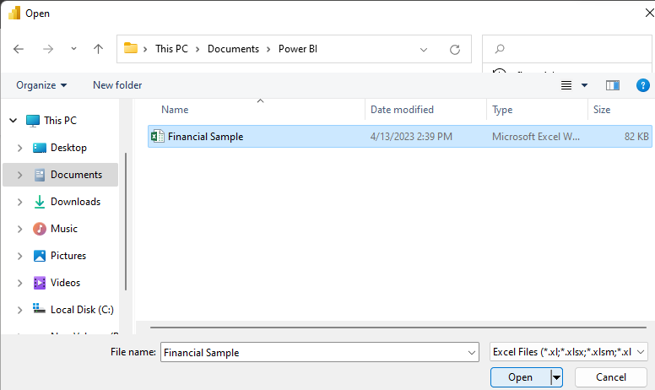
Connecting to various data sources
Select Excel from the Get Data window, then select the Connect button.
3. Power BI prompts you to provide the location of the Excel file to which to connect.
Select that file, and then select Open.

Slide 16
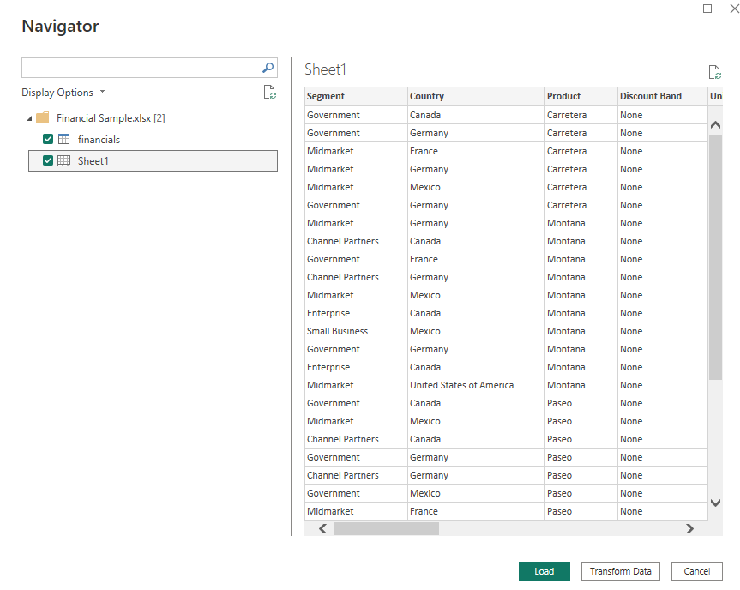
Connecting to various data sources
4. Power BI Desktop then loads the workbook and reads its contents, and shows you the available data in the file using the Navigator window.
In that window, you can choose which data you would like to load into Power BI Desktop. Select the tables by marking the checkboxes beside each table you want to import.
5. select Load to import the data into Power BI Desktop.
Once you've loaded the tables, the Fields pane shows you the data.

Slide 17
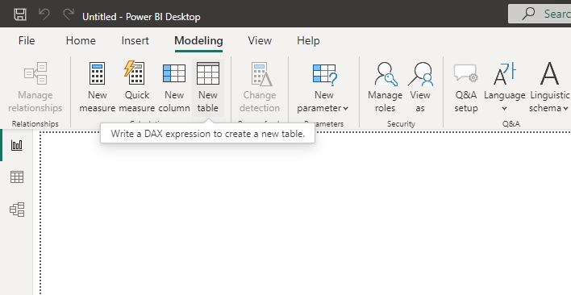
Creating manual datasets for analysis
Power BI Desktop is all about connecting to data, modeling that data, and then visualizing that data. Therefore, it makes sense that you cannot really do much within Power BI without data.
Now that we have a basic understanding of Power BI and its user interface let's move on to creating our first table in Power BI manually. Here are the steps to follow:
Open Power BI Desktop and click on the Modeling tab.
Click on the "New Table" button in the ribbon. The formula bar will appear with the words Table =, and the cursor will become active within the formula bar.

Slide 18
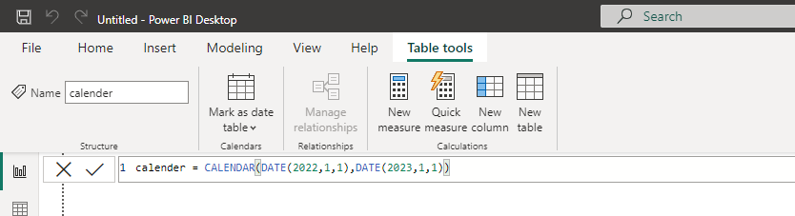
Creating manual datasets for analysis
3. Type the formula into the formula bar, replacing the existing text:
This formula creates a table named Calendar that has a single column called Date. This table and column will appear in the Fields pane.
The CALENDAR function is a DAX function that takes as input a start date and an end date. We used another DAX function, DATE, to specify the start and end dates of our calendar. The DATE function takes a numeric year, month, and day value and returns a date/time data type representative of the numeric inputs provided.
Press the Enter key on the keyboard to create a table called Calendar in your data model. Switch to the Data view to observe the table created

Slide 19
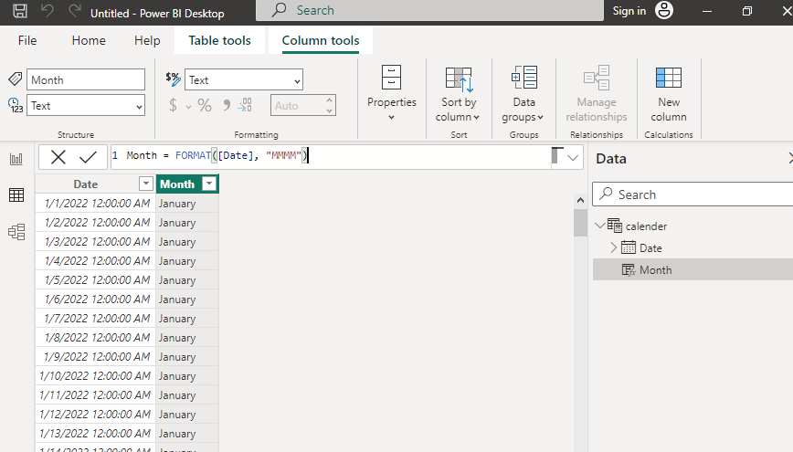
Creating manual datasets for analysis
Creating calculated column
While we are in Data view, let's add some additional data to our simple, single-table data model
1. Make sure that the Calendar table is selected in the Fields pane and then click the Table tools tab in the ribbon.
2. Click on New Column in the ribbon and a new column named Column will appear in your table.
3. Type this new formula into the formula bar, completely replacing all existing text, and press the Enter key to create the column
The FORMAT function to create a friendly month name, such as January instead of 1. Within this formula, we refer to our Date column created previously using the column name prefixed and suffixed with square brackets ( [ ] ).

Slide 20
Managing data sources
When you need to view or manage an external data source, it pays to know the right dialog box for your needs:
Use the Recent Sources dialog box to display frequently used data sources that you have already imported and as a convenient list for making changes to the connection information of each data source.
Use the Edit Permissions dialog box to locate or update data source credentials or to set privacy levels. For more information.
Use the Query Options dialog box to set additional security options on native database queries, certificates, and authentication services. Boost the safety level of your data even further.

Slide 21
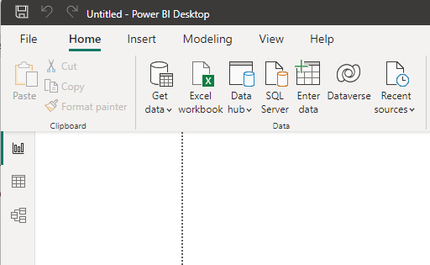
Views in power BI
Report view – You can use queries that you create to build compelling visualizations, arranged as you want them to appear, and with multiple pages, that you can share with others.
Data view – See the data in your report in data model format, where you can add measures, create new columns, and manage relationships.
Model view – Get a graphical representation of the relationships that are established in your data model, and manage or modify them as needed.
Access these views by selecting one of the three icons along the left side of Power BI Desktop. In the following image, Report view is selected, indicated by the green band beside the icon

Slide 22
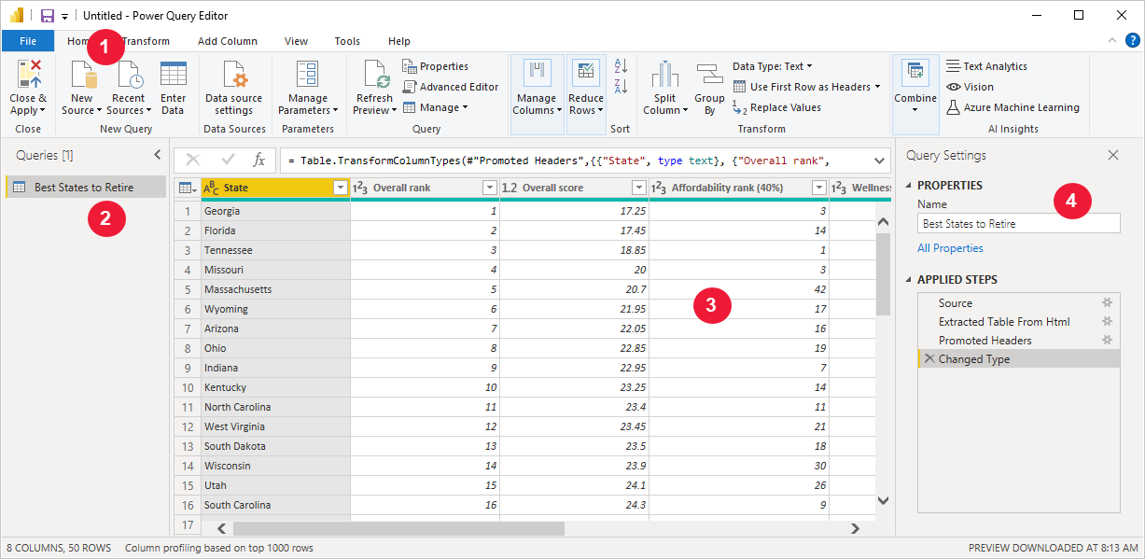
Power Query Editor
With Power Query Editor, you can connect to one or many data sources, shape and transform the data to meet your needs, then load that model into Power BI Desktop
Power Query Editor appears after a data connection is established:
1. In the ribbon, many buttons are now active to interact with the data in the query.
2. In the left pane, queries are listed and available for selection, viewing, and shaping.
3. In the center pane, data from the selected query is displayed and available for shaping.
4. The Query Settings pane appears, listing the query's properties and applied steps.

Slide 23
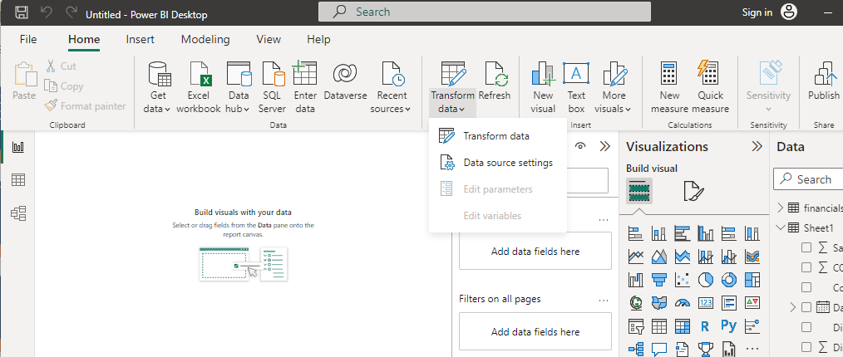
Loading and transforming data
After the data has been loaded, it becomes visible under the Fields Tab. From here, we can modify our datasets with the help of Query Editor. Query editor can be used for modifying datasets irrespective of their data source. We can do manipulations like renaming a dataset, removing a single or multiple columns, etc. in the query editor. The Query Editor can be accessed by clicking the Queries on the Home Ribbon.

Slide 24
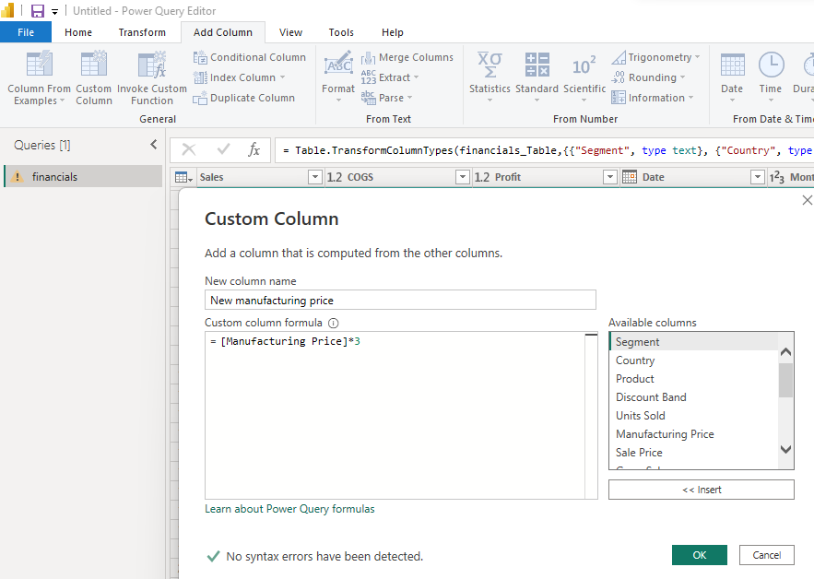
Loading and transforming data
Creating a Custom Column
Using the Financial data, let’s shape data to meet our needs. Let’s create a custom column called New Manufacturing Price

Slide 25
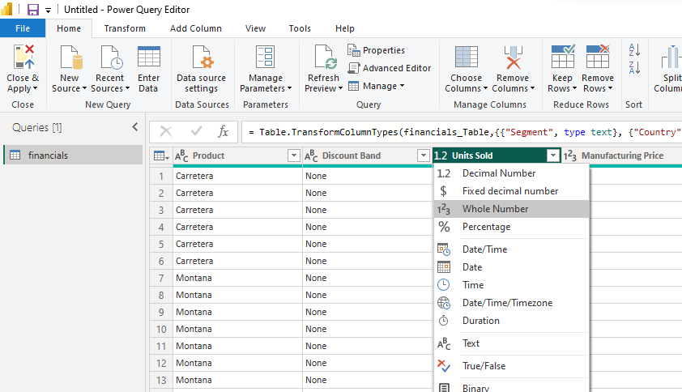
Loading and transforming data using Data View and Query Editor
Changing Column Data Types
The data types of the columns can also be changed easily. The Units Sold column has a floating point data type which can be adjusted to a whole number.

Slide 26
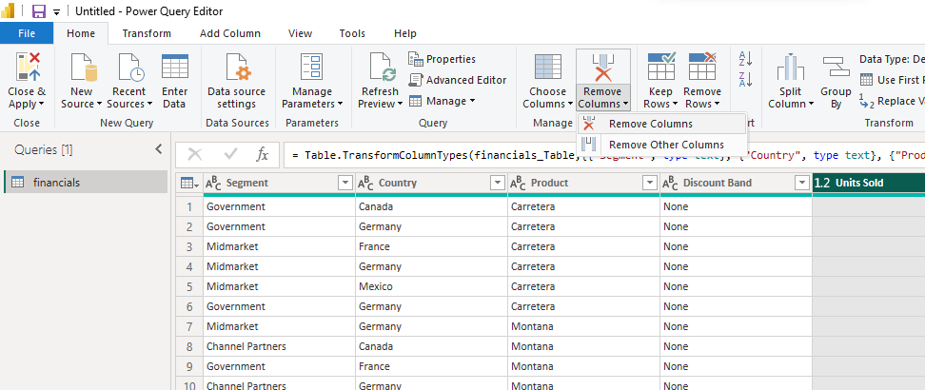
Loading and transforming data using Data View and Query Editor
Removing Columns
Removing columns is also easy. Simply select the column to be selected and choose the Remove Columns option, as shown in the following figure. Let’s get rid of the Discount column as it is adding no value to our dataset.
Similarly, there are other multitudes of functions that can be carried out like removing and adding rows, transpose, pivot and split which can be easily achieved through the query editor. Note that all the steps that you undertake to transform your data also appears in the Query Settings panel.

Slide 27
LESSON 3:
Data Modeling and Visualization

Slide 28
Introduction to Data Analysis Expressions (DAX)
DAX (Data Analysis Expressions) is a syntax language that includes formulas and expressions used to manipulate data. Functions, constants, and operators are used in DAX expression. DAX is a better version of Microsoft Excel, providing high-end data manipulation and management capabilities.
Microsoft made DAX language to complement its business intelligence and data modelling tools like PowerPivot and Power BI.
Importance of Data Analysis Expression in Power BI
DAX is quite an important part of BI because it provides functionalities like:
Data Visualizations
Importing, and manipulating data that are designed for the end-user.
For normal report creation, a brief understanding of the dashboard is enough.
However, DAX helps to create sophisticated and insightful reports.
With several commands and measures available in DAX syntax, the generated reports are highly intuitive and discerning.
How does DAX Work?
DAX is built around three fundamental concepts:
1. Syntax: Formula syntax refers to the shape of the formula you are constructing. It is the language used to make the formula, for example, command, sign, operators, destination column or row, etc. Example: name, parenthesis, summation, name of the table.
2. Functions: A function refers to a predefined or already existing command in a system. Examples include sum, add, true, false, etc.
3. Context: The context refers to the row that has been included in the formula for data retrieval or calculation. There are two types of context: Row Context and Filter Context.

Slide 29
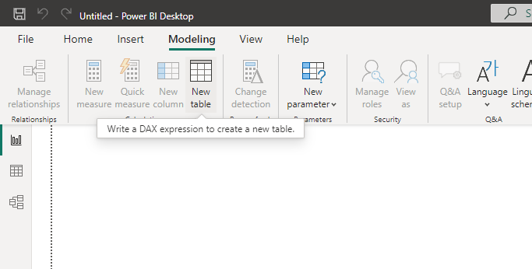
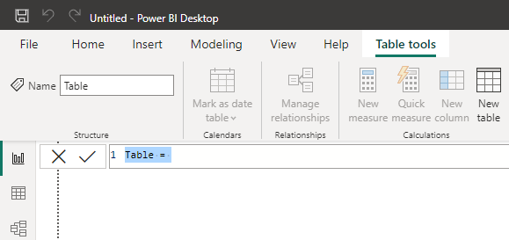
Creating new tables, and columns using DAX
Make a new file in Power BI Desktop. Then select New Table from the Modeling tab.
This will create a table called Sample Table, with one single column called “Value”, and the value in the only row for that would be 1. The Value column automatically takes the data type of the Whole Number

Slide 30
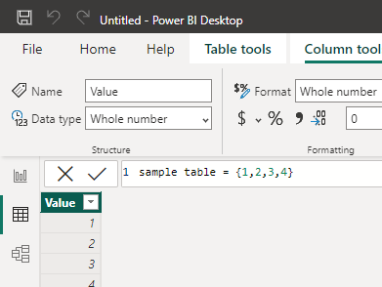
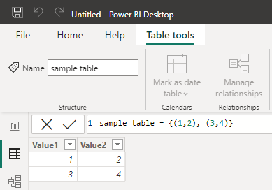
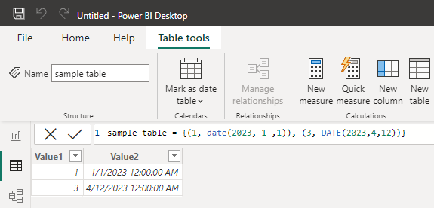
Creating new tables, and columns using DAX
A table with two or three rows
Multiple rows and columns in the table

Slide 31
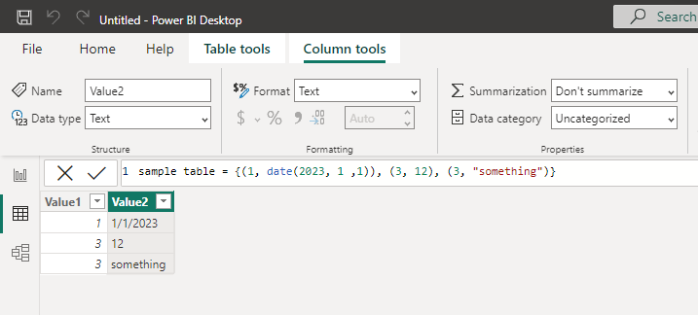
Creating new tables, and columns using DAX
You can have different data types in each column using the Table Constructor, but Power BI will convert all values to the same data type.
Limitations of Creating Power BI New Table Using DAX Table Constructor
When you use Constructors, the values of cells and rows can be any values you want. However, the number of columns in each row should be the same, or else it shows an error.
Value1, Value2, Value3,…. are always the column names, and you can’t change them in the Table Constructor. You can change it later by simply renaming it or by using the SelectColumns function. Column data types are defined automatically, and you can then change them manually.
Because of these two drawbacks, it is preferred to use the DAX Datatable function, which provides you with more options and flexibility.

Slide 32
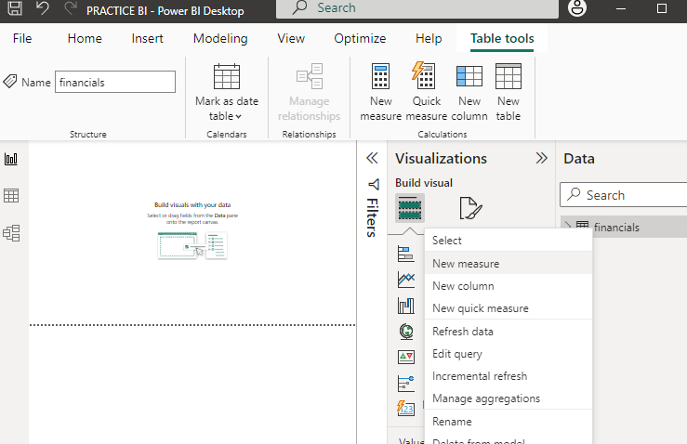
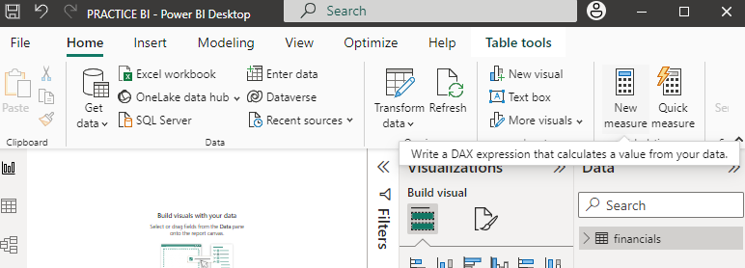
Creating new measures using DAX
You can have different data types in each column using the Table Constructor, but Power BI will convert all values to the same data type.
In the Fields pane, right-click the financial table, or hover over the table and select More options (...).
From the menu that appears, choose New measure.
This action saves your new measure in the Sales table
You can also create a new measure by selecting New Measure in the Calculations group on the Home tab of the Power BI Desktop ribbon.

Slide 33
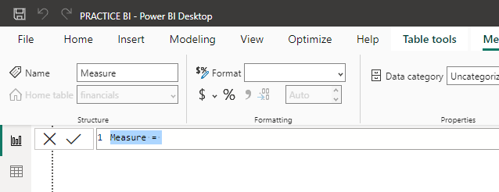
Creating new measures using DAX
The formula bar appears along the top of the report canvas, where you can rename your measure and enter a DAX formula.
By default, each new measure is named Measure. If you don’t rename it, new measures are named Measure 2, Measure 3, and so on. Because we want this measure to be more identifiable, highlight Measure in the formula bar, and then change it to Net Sales.
Begin entering your formula. After the equals sign, start to type Sum. As you type, a drop-down suggestion list appears, showing all the DAX functions, beginning with the letters you type. Scroll down, if necessary, to select SUM from the list, and then press Enter.

Slide 34
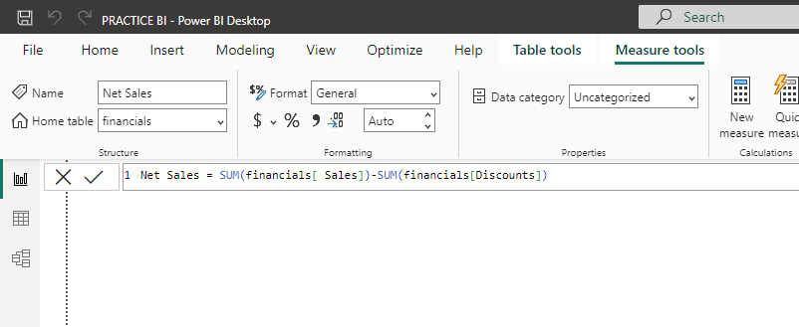
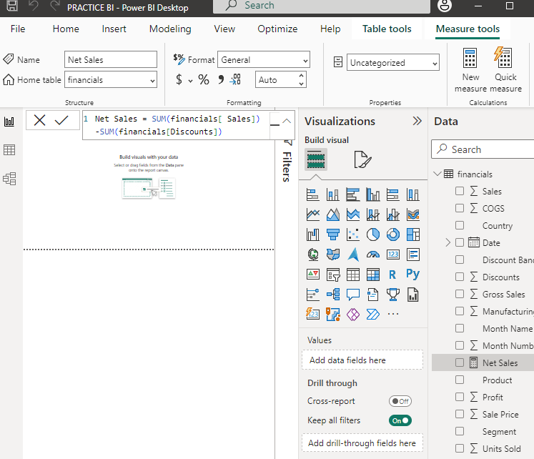
Creating new measures using DAX
Press Enter or select Commit (checkmark icon) in the formula bar to complete and validate the formula.
The validated Net Sales measure is now ready to use in the Sales table in the Fields pane

Slide 35
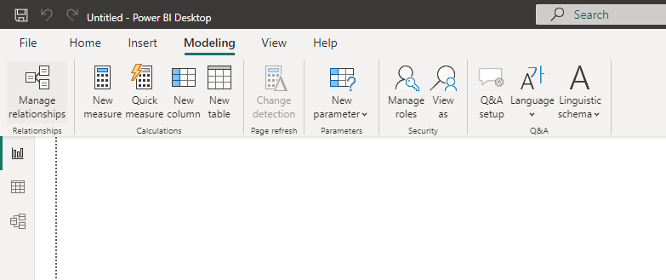
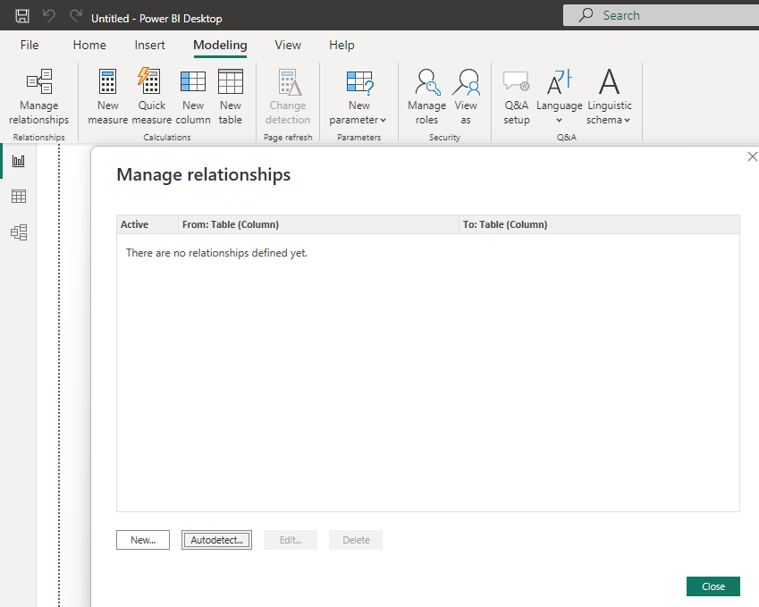
Establishing and managing relationships between data tables
Create a relationship with AutoDetect
On the Modeling tab, select Manage relationships > AutoDetect.

Slide 36
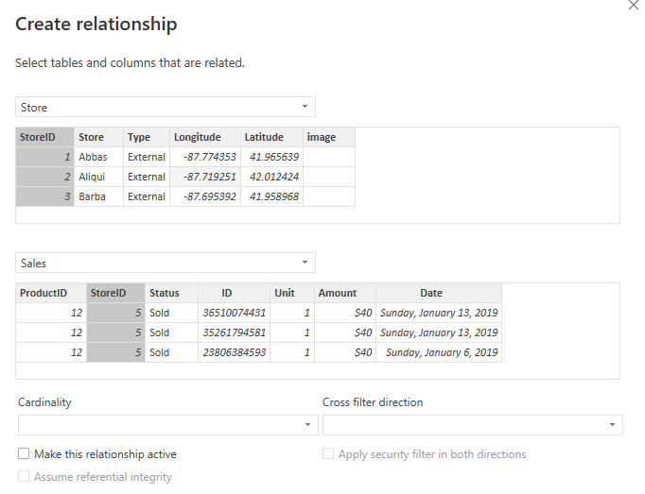
Establishing and managing relationships between data tables
Create a relationship manually
On the Modeling tab, select Manage relationships > New.
In the Create relationship dialog box, in the first table drop-down list, select a table. Select the column you want to use in the relationship.
In the second table drop-down list, select the other table you want in the relationship. Select the other column you want to use, and then select OK

Slide 37
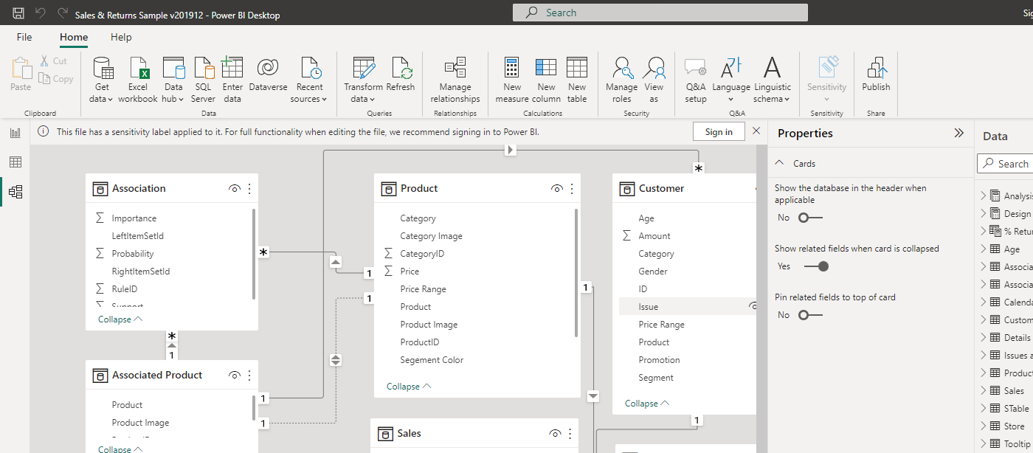
Establishing and managing relationships between data tables
Edit a relationship
There are two ways to edit a relationship in Power BI.
The first method to edit a relationship is using the Editing relationships in the Properties pane in Model view, where you can select any line between two tables to see the relationship options in the Properties pane. Be sure to expand the Properties pane to see the relationship options.

Slide 38
Establishing and managing relationships between data tables
Edit a relationship
2. The other method of editing a relationship is using the Relationship editor dialog, which you can open many ways from within Power BI Desktop. The following list shows different ways you can open the Relationship editor dialog:
From Report view do any of the following:
Select the Modeling ribbon > Manage relationships, then select the relationship and select Edit.
Select a table in the Fields list then select the Table tools ribbon > Manage relationships, then select the relationship and then select Edit.
From the Data view, select the Table tools ribbon > Manage relationships, then select the relationship and then choose Edit.
From the Model view do any of the following:
Select the Home ribbon > Manage relationships, then choose the relationship and then select Edit.
Double-click any line between two tables.
Right-click any line between two tables and then choose Properties.
Select any line between two tables, then choose Open relationship editor in the Properties pane.
Finally, you can also edit a relationship from any view, right-click or select the ellipsis to get to the context menu of any table, then select Manage relationships, select the relationship and then select Edit

Slide 39
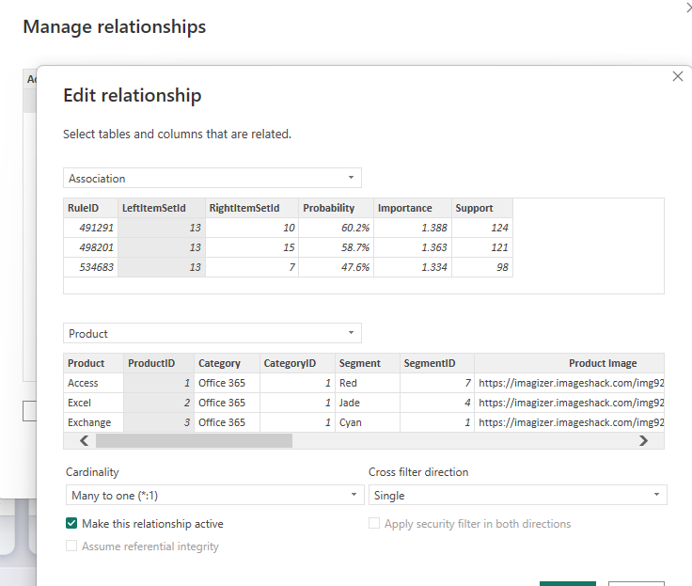
Establishing and managing relationships between data tables
Edit a relationship

Slide 40
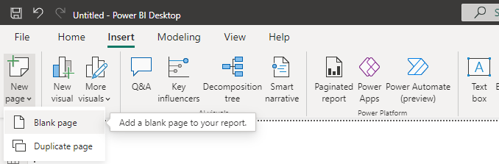
Organizing report pages
Report view is where you can create any number of report pages with visualizations. Report view in Power BI Desktop provides a similar design experience to the report's editing view in the Power BI service. You can move visualizations around, copy and paste, merge, and so on.
A report has at least one blank page to start. Pages appear in the navigation area at the bottom of the Report view. You can add all sorts of visualizations to a page, but it's important not to overdo it. Too many visualizations on a page make it look busy and difficult to find the right information. You can add new pages to your report.
Just select New page from the Insert tab on the ribbon, and then select Blank page.
You can also select the + icon next to the pages in the navigation area below the canvas to create a new page.

Slide 41
LESSON 4:
Advanced Visualizations and Reports

Slide 42
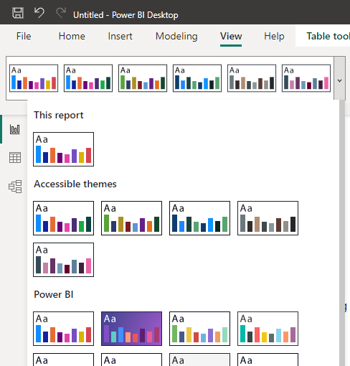
Customizing report view
Using theme
In Power BI Desktop, while in the Report view, click on the View tab. Then, in the Themes section, click the drop-down arrow and choose Browse for themes.

Slide 43
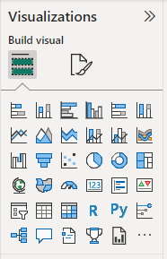
Creating diverse visualizations
Visualizations (known as visuals for short) display insights that have been discovered in the data. A Power BI report might have a single page with one visual or it might have pages full of visuals.
Every day your business generates more data on sales revenue, marketing performance, customer interactions, inventory levels, production metrics, staffing levels, costs, and other KPIs. But with so much data to sift through, it can be difficult for people to see the story it tells.
Data visualization helps you turn all that granular data into easily understood, visually compelling—and useful—business information. By tapping into external data sources, today’s data visualization tools don’t simply let you see your KPIs more clearly, they unify data and apply AI-driven analytics to reveal relationships between your KPIs, the market, and the world.
There are many different visual types available directly from the Power BI Visualizations pane.

Slide 44
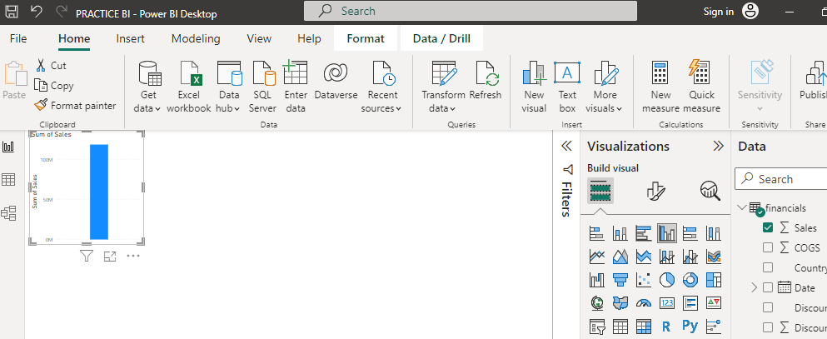
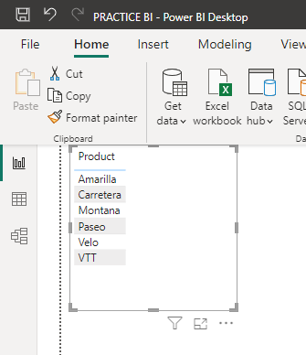
Creating diverse visualizations
Add a visualization
Start with a numeric field like > Sales. Power BI creates a column chart that has a single column:
With a field like Product, Power BI creates a table and adds that field to the Columns section

Slide 45
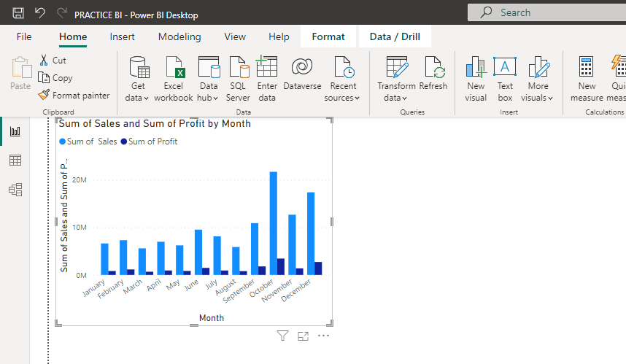
Creating diverse visualizations
Add a visualization

Slide 46
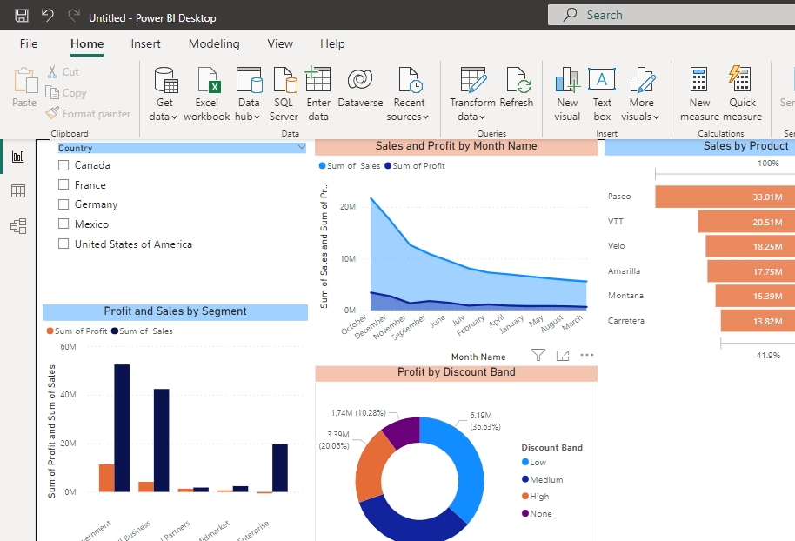
Creating diverse visualizations

Slide 47
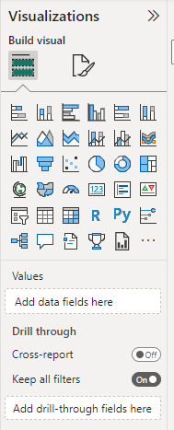
Drill-through and Drill-down
Drill-through in Power BI reports, you can create a destination target page in your report that focuses on a specific entity such as a supplier, customer, or manufacturer. When your report readers right-click a data point in other source report pages, they drill through to the target page to get details that are filtered to that context.
Set up the drill-through target page
To set up drill-through, create a target report page that has the visuals you want for the type of entity that you're going to provide drill-through for.
For example, suppose you want to provide drill-through for manufacturers. You might create a drill-through target page with visuals that show total sales, total units shipped, sales by category, and so on. That way, when you drill through to that page, the visuals are specific to the manufacturer you selected.
Then, on that drill-through target page, in the Build visual section of the Visualizations pane, drag the field for which you want to enable drill-through into the Drill through well.

Slide 48
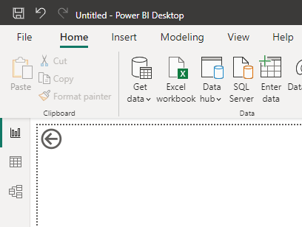
Drill-through and Drill-down
When you add a field to the Drillthrough filters well, Power BI automatically creates a back button visual. That visual becomes a button in published reports. Users who view your report in the Power BI service use this button on the target page to get back to the original source report page from which they came.

Slide 49
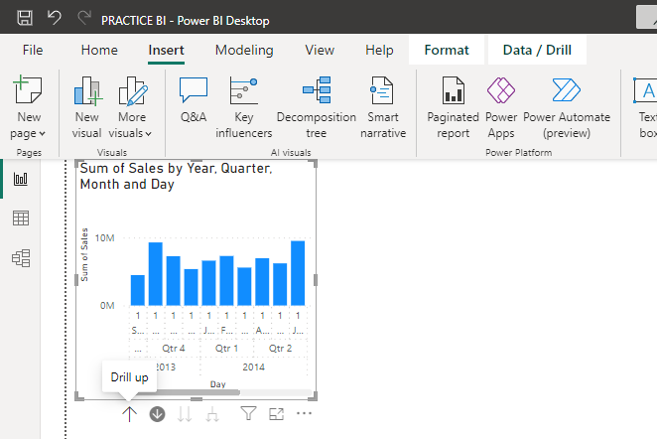
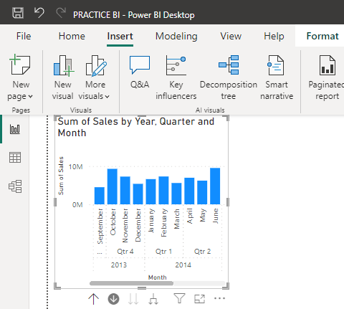
Drill-through and Drill-down

Slide 50
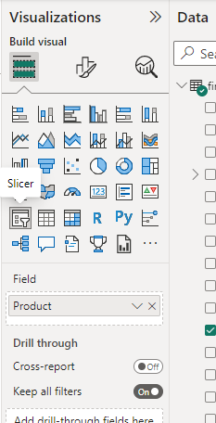
Slicers and filters.
Slicers are another way of filtering. They're displayed on the report page, and narrow the portion of the dataset that's shown in the other report visualizations
Display commonly used or important filters on the report canvas for easier access.
Make it easier to see the current filtered state without having to open a drop-down list.
Filter by columns that are unneeded and hidden in the data tables.
Create more focused reports by putting slicers next to important visuals.
Create a slicer
Open the file in report view.
On the Overview page, with nothing selected on the report canvas, select the Slicer icon in the Visualizations pane to create a new slicer.

Slide 51
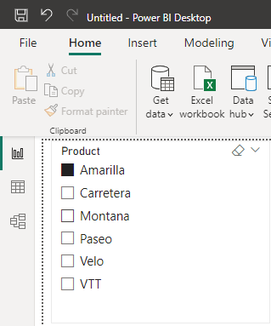
Slicers and filters.
Create a slicer
With the new slicer selected, from the Fields pane, select field to populate the slicer.
Resize and drag the elements on the canvas to make room for the slicer. If you resize the slicer too small, its items are cut off.

Slide 52
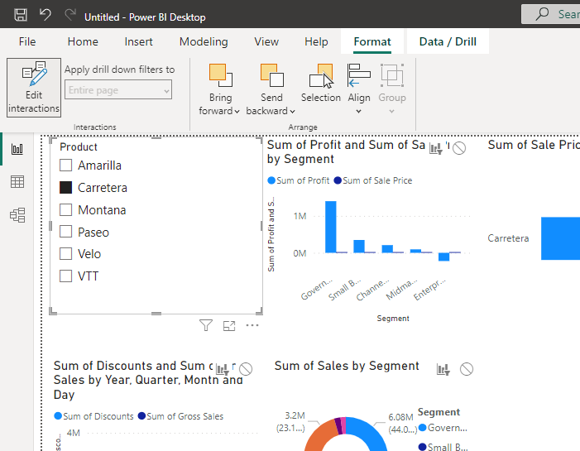
Slicers and filters.
Control which page visuals are affected by slicers
Select a slicer that you previously created
Select the Format ribbon, then select Edit interactions.

Slide 53
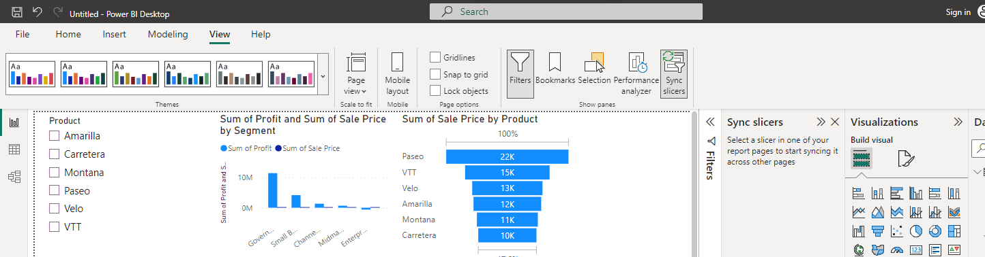
Using Sync slicers
You can sync a slicer and use it on any or all pages in a report.
With the Sync slicers pane, you can sync the slicer to these pages, so that slicer selections on any page affect visualizations on all three pages.
In Power BI Desktop on the View ribbon, select Sync slicers.
The Sync slicers pane appears between the Filters and Visualizations panes.

Slide 54
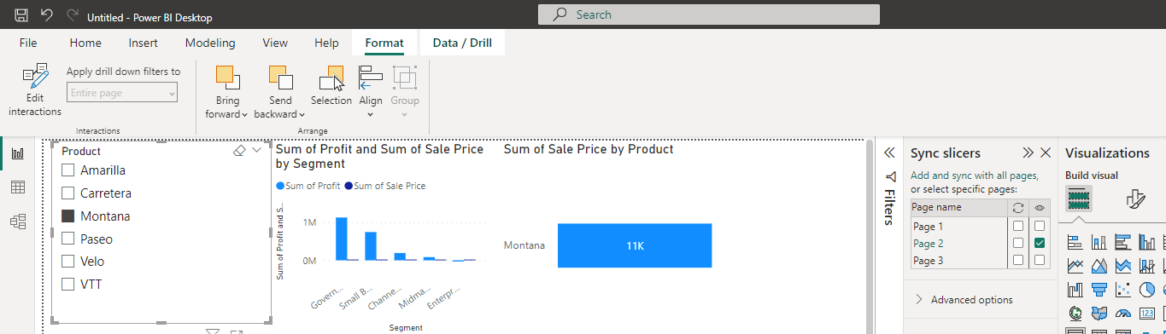
Using Sync slicers
On the page of the report, select an already created slicer.
In the Sync column of the Sync slicers pane, select the pages.
This selection causes the slicer to sync across these pages.
Observe the effects of syncing the slicer and making it visible on the other pages..

